Slide 1

Academic library website: A practical experience
Sri Raja Biswas
Librarian, Senior Scale, Vidyasagar College,
39, Sankar Ghosh Lane, Kolkata- 700006, West Bengal, India
raja.biswas@gmail.com
And
Dr. Swapna Banerjee
Associate Professor, DLIS, University of Calcutta,
Kolkata, West Bengal, India
swapna.banerjee98@gmail.com

Slide 2


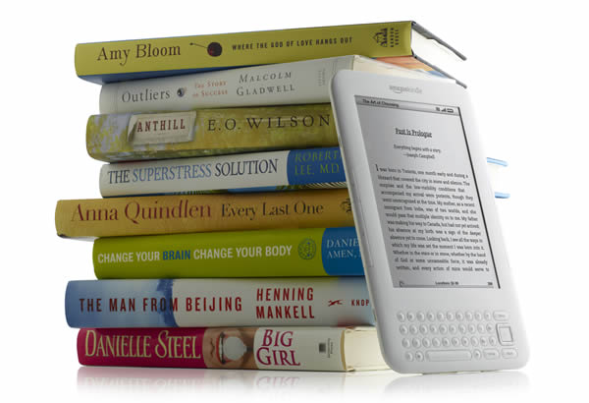
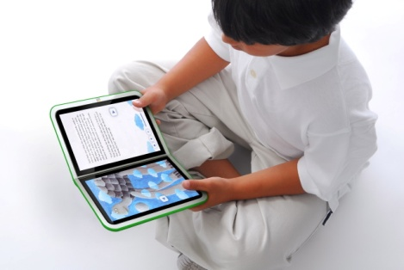
21st Century Library
In the last four decades, computer technology has created a revolution and library is not the exception. Most significant changes are:
Technology changes traditional information forms.
Digitization changes the landscape of information access and use.
New information processes are changing libraries, library services, and librarians.
In this transitional period, librarians need diverse level of technical skills not only to carry out day to day operations but also for the implementation of new technologies in this field.
Technology & changing nature of the library itself

Slide 3

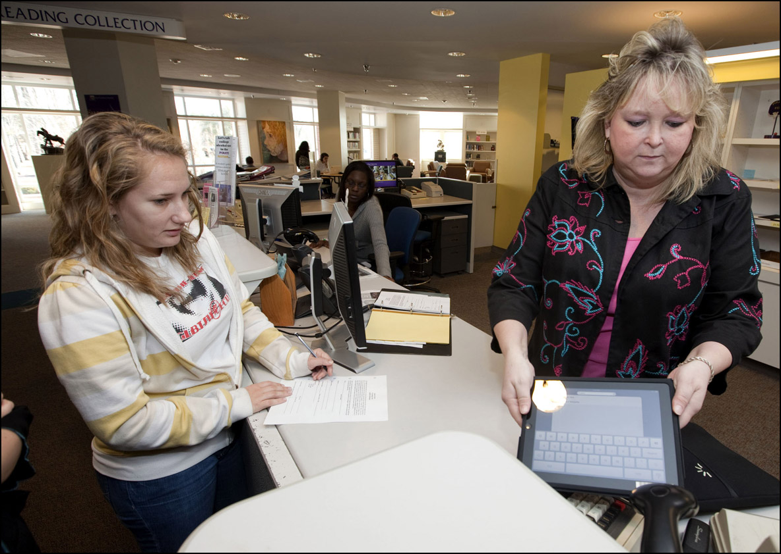
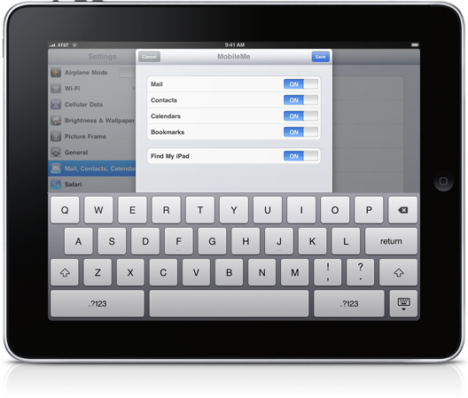
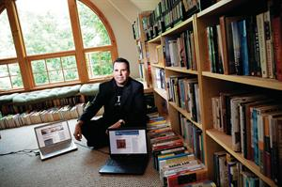
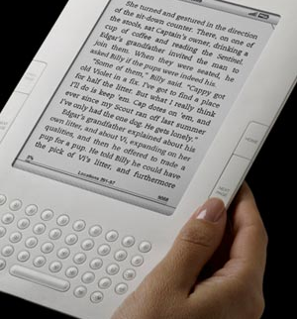
Transformation
ipad
Kindle
Notes:
Book to electronic format
Portable reader: ipad, kindle, etc

Slide 4
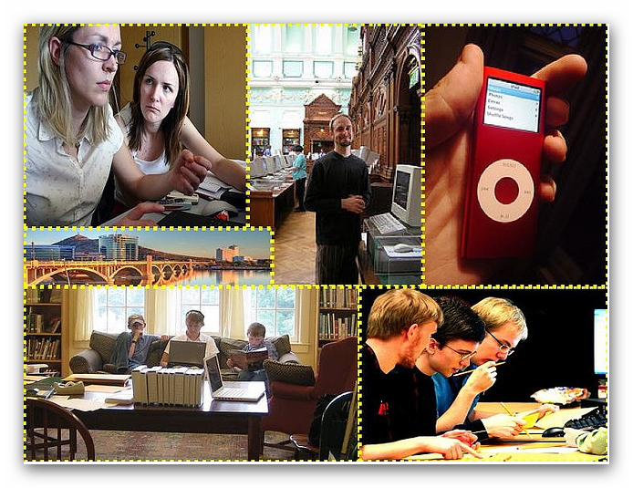
21st Century Library
It is not only technology that has changed, but also the mindset & information seeking pattern of the library users have changed a lot. Significant changes are as follows:
readers no longer concentrate on a single type of activity. They simultaneously concentrate in their evaluation tasks, social activities and entertainment. Work and social activities are highly interlinked. Technological innovations open up these possibilities and the user’s behavior are adapting to them
They prefer browser based searching, as they may able to use available information sources & systems of their own. The Internet is being used for empirical research as well as for entertainment based activities
They believe in collaboration & sharing
Changing nature of the user
Notes:
collaboration & sharing are the building blocks of Social Networking.

Slide 5
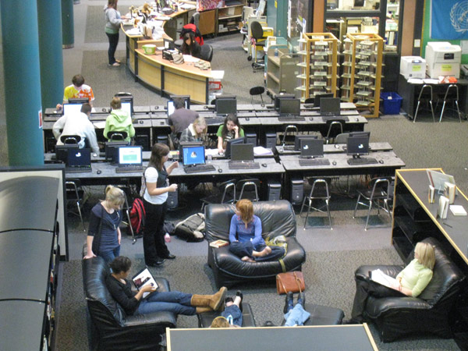
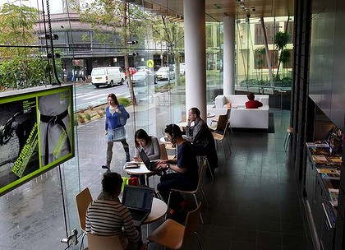
Multitasking & relaxed user

Slide 6
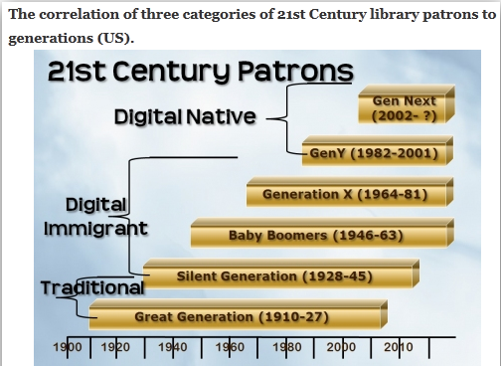
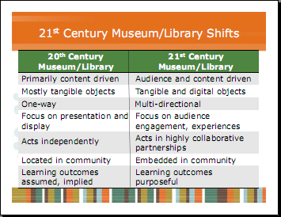
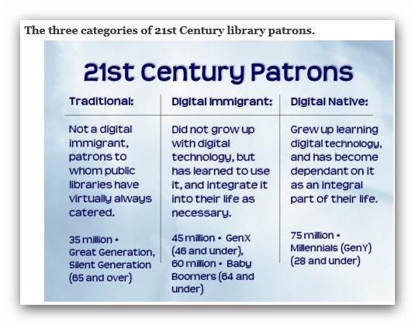
Changes are everywhere: User & information service due to available technology…
Notes:
Source: http://21stcenturylibrary.wordpress.com/2010/05/12/21st-century-patrons-revisited/

Slide 7


The existence of libraries themselves have been questioned... In this digital era
Now a days, it is very common to find and resolve any questions with the help of search engines like Google, Yahoo, etc. However, after working with intuitive search tools the student or the researcher will become aware of their limits and seek professional support.
This point is very important in libraries point of view because if the users feel satisfied with the information provided from the reference desk, or through library portal then they may think to use it again. Otherwise, libraries would lose its relevance in this “Google Era”.
Libraries can be relevant.......if they change.
Notes:
Intuitive- Using or based on what one feels to be true even without conscious reasoning; instinctive.
(chiefly of computer software) Easy to use and understand

Slide 8

College library users’ survey
Reducing number of library user
Non-use of valuable books (although books were purchased based on users’ suggestions)
Users are not interested to browse OPAC
Users are eager to access Facebook, Orkut and other mail services like Gmail, Y-mail, etc.
Findings:
1. Users’ always expect readymade solutions
2. Libraries have to reach to its users and inform them about its new additions, services, readymade solutions, etc.
Notes:
Library Services – • Exactly what library services fulfill 21st Century customers’ needs? • How do we determine what library services we should offer in the 21st Century?

Slide 9
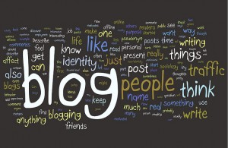
Possibilities
We have found that almost every renowned institutes of the world have its own blog. This Blogs are Web 2.0 compatible and allows interaction with its users. Moreover these Blogs are interlinked with Facebook, Twitter, Flickr, etc.
Notes:
1. Ultimately injecting information to its users.

Slide 10
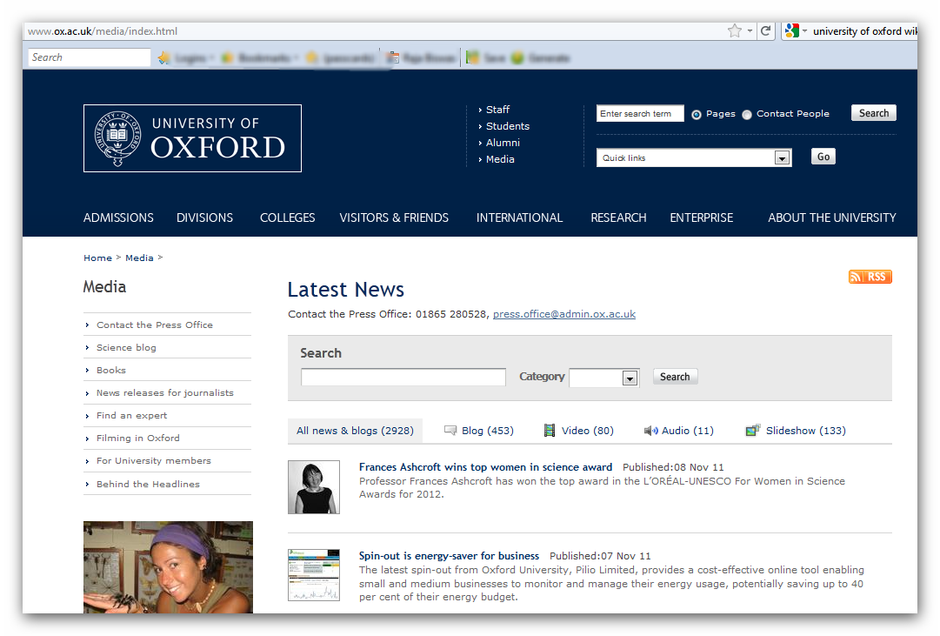
Institutional webpage offering options for blogs, video, audio, slide shows…

Slide 11
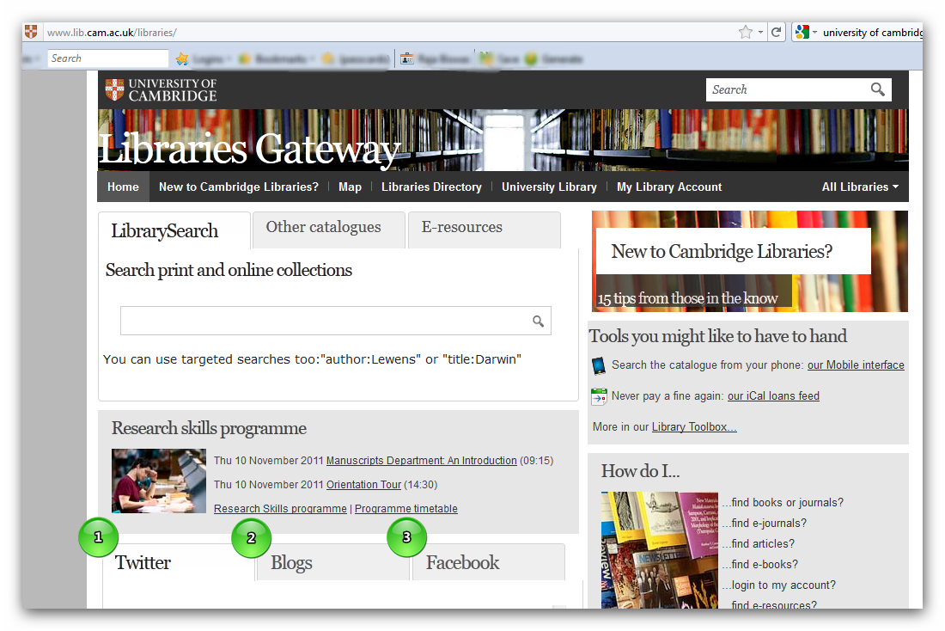
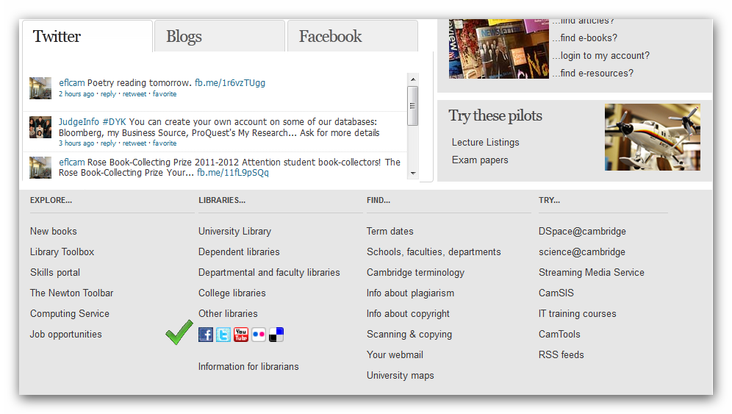
University of Cambridge: Library webpage

Slide 12
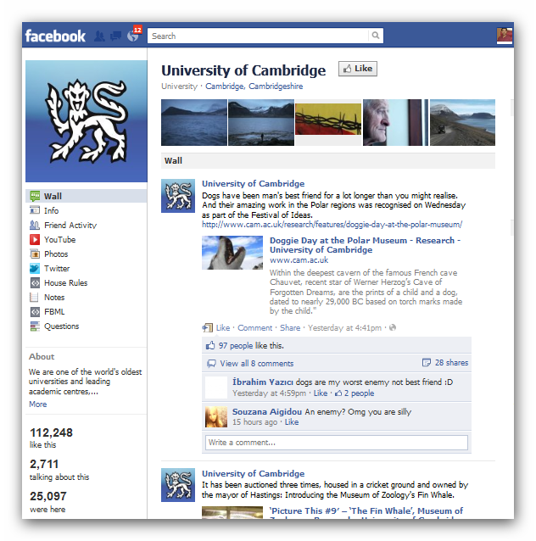
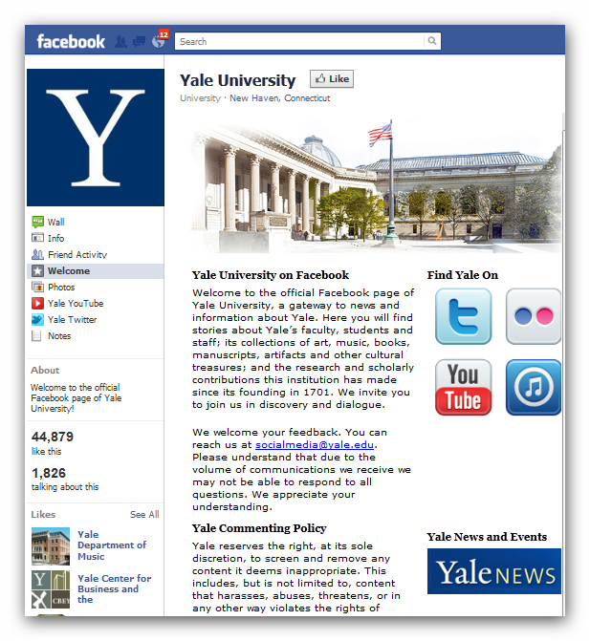
Some examples: 1

Slide 13
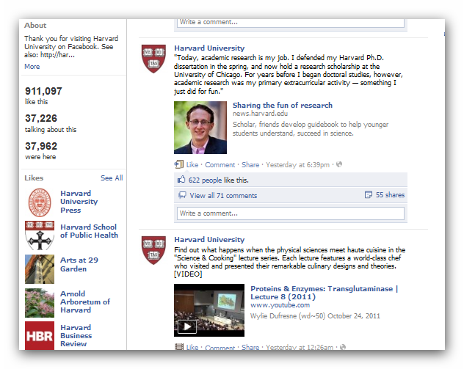
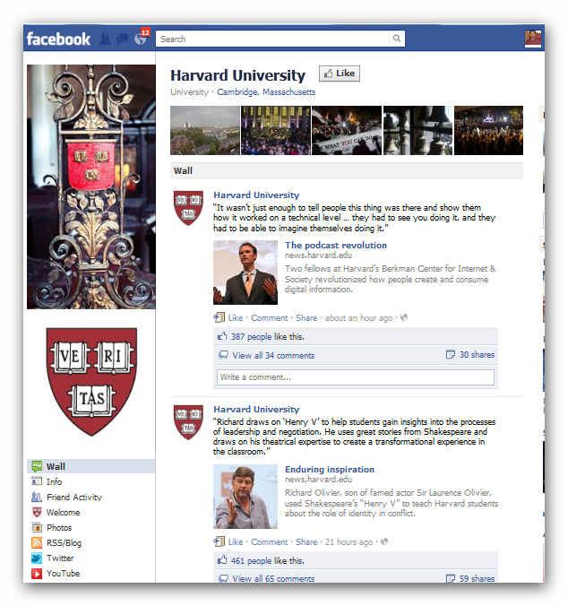
Some more examples: 2

Slide 14
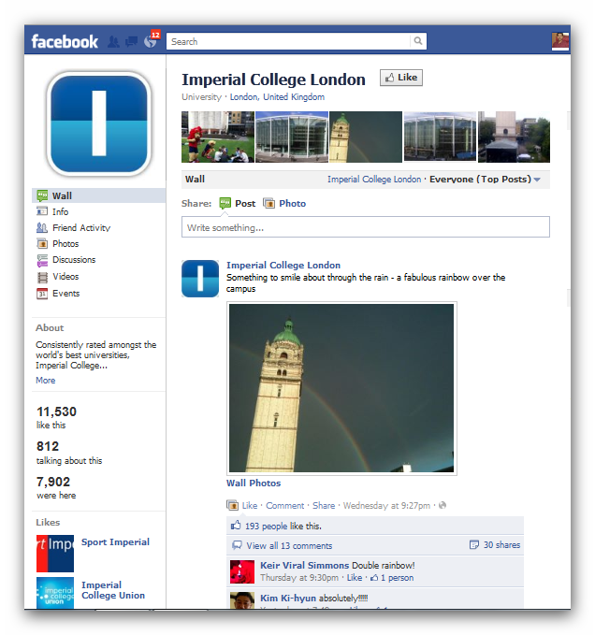
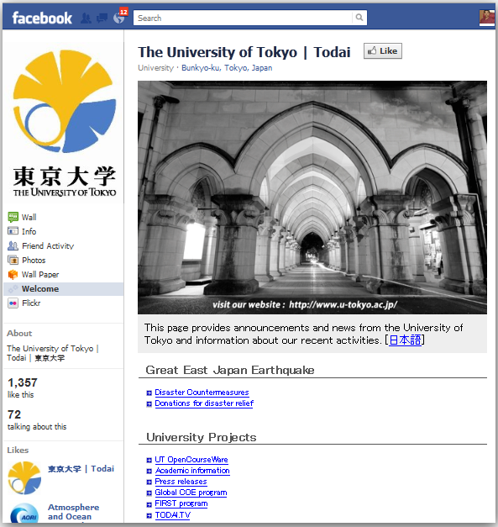
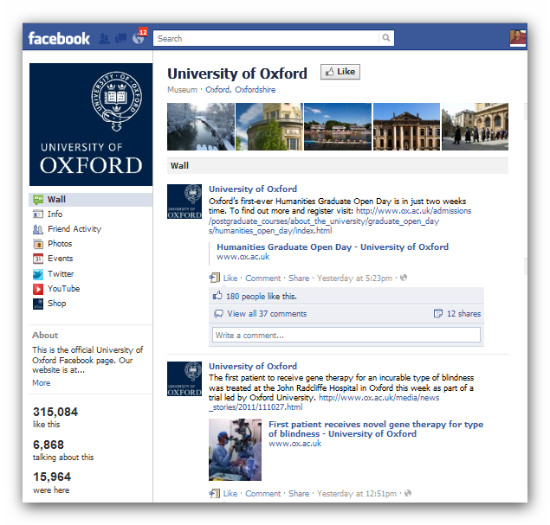
Examples: 3

Slide 15

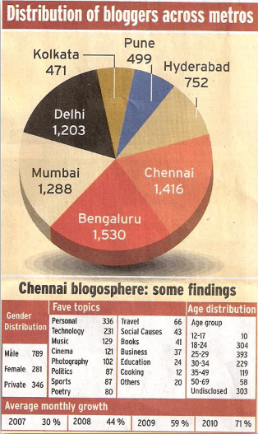
Indian scenario
Very few College Library have taken any initiatives in this regard.
College Websites are mainly created to fulfill its admission processes or informing users about its institution only. These are updated once in a year, just before the admission.

Slide 16

Identified problems
Lack of vision in the administrators part
Budgetary constrains
Lack of initiatives by the Librarians just because of the lack of self confidence & expertise (it was true in my case also)
Our mission
We tried to implement one Library Blog, without taking any help from others, without any money and HTML knowledge!
…a self sufficient Librarian

Slide 17
Goals to be achieved
Making a balance between new information service initiatives and expectations of technology savvy users.
Upgrading existing systems and services of the library, with dynamic digital technologies to meet the expectations of its existing users and to attract potential users.
Providing support for collaboration and cooperation among users.
Ensuring multidirectional information flow and content creation.
Web 2.0 enabled dynamic virtual space for all
Webpage & blogging options
Provision for forum, poll, multimedia presentation
Linking with other community sites, multilingual interface , RSS feed, spam blocking

Slide 18
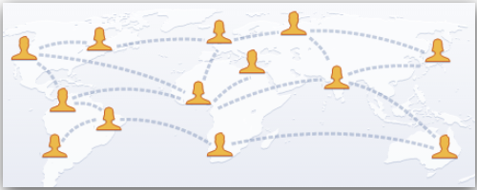



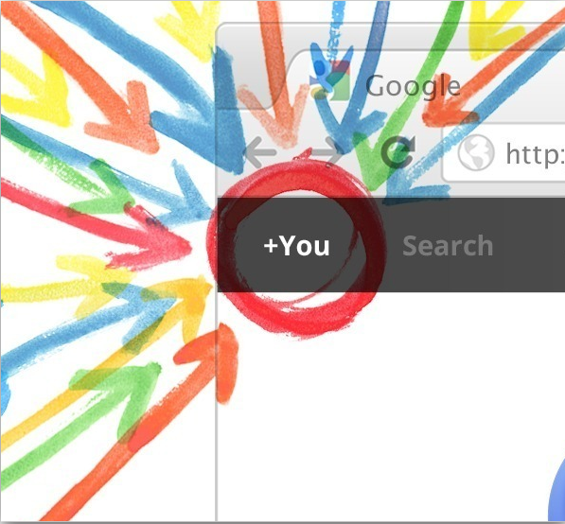






Blog can able to integrate all these tools and force a user to follow news feeds for them…
USER
Notes:
Our Goal! Information network through a Blog by integrating all popular social networking sites in it…

Slide 19





Available options
WordPress is a state-of-the-art publishing platform with a focus on aesthetics, web standards, and usability. The project was started in 2003. Since then it has grown to be the largest self-hosted blogging tool in the world, used on millions of sites and seen by tens of millions of people every day.
Drupal is a content management platform that allows an individual or community of users to easily publish, manage, and organize a wide variety of content on a website. In general, Drupal is used for community web portals, discussion sites, corporate web sites, intranet applications, personal web sites or blogs, e-commerce applications, resource directories, and social networking sites.
Joomla! is an open source Content Management System with a growing and active community of more than 400,000 users. Joomla! creates multiple format sites from simple websites to complex corporate applications and allows users to manage each aspect of their website through a simple, browser-based interface. (Apache, MySQL, PHP and phpMyAdmin).
OSQA is a sophisticated Open Source Q&A System that can help to manage and grow online communities. OSQA is written in Python and powered by the Django application framework. (Apache, PostgreSQL, Python and Django).
All these are free but requires multiple software for its installation
Each & every software may be suitable for building library blog

Slide 20
Struggle
Remedy
Content Management System: WordPress
No installation, no maintenance and no configuration needed. Moreover updating the existing version with the new releases takes place automatically
Best ratings & award winner for the last 4 years
Support both Portal and Blogging options with spam protection
No unwanted advertisement even in the free site, ensures professional look. Provides 3 GB space for free sites.
Platform independent
Library 2.0 compliant
A system suited best for all- novice to experts in this field
Instant implementation without HTML knowledge
Extensive support available through active users’ community
Supports multilingual interface, RSS feed, tagging, searching, linking other resources, e-mail subscription, forum, polls, etc.
Money- required for web space
Selection of software & its installation
Lack of expertise, guidance & technical knowledge

Slide 21
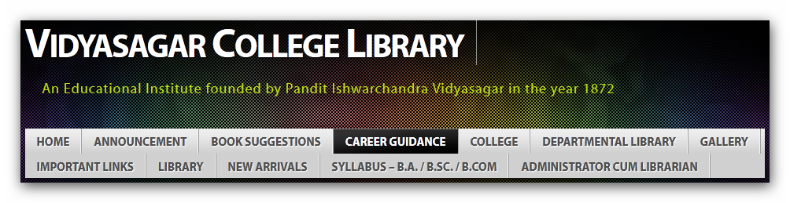
Success!
We were ultimately able to build our blog for Vidyasagar College Library
Yes this is the beginning of our dream… a webpage without a single line of HTML!
College authorities also appreciated this effort and included the news of introduction of Vidyasagar College Library Blog in its Annual Report 2011.
Site administrator is the LIBRARIAN. This is the thing which may regain Librarians’ status.
http://vclibrary.wordpress.com

Slide 22

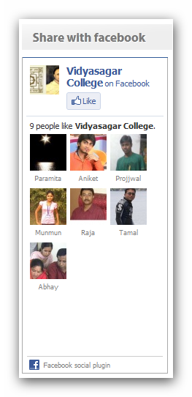
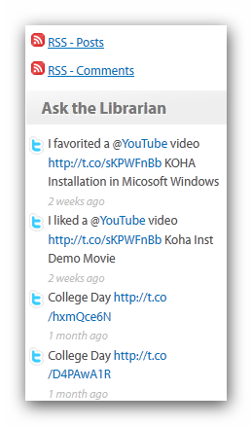
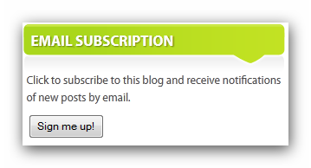
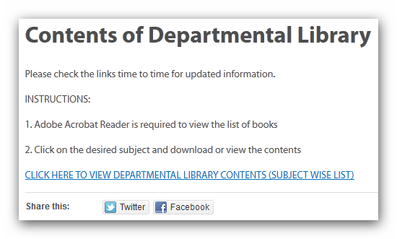
Our Blog: Some features- 1

Slide 23
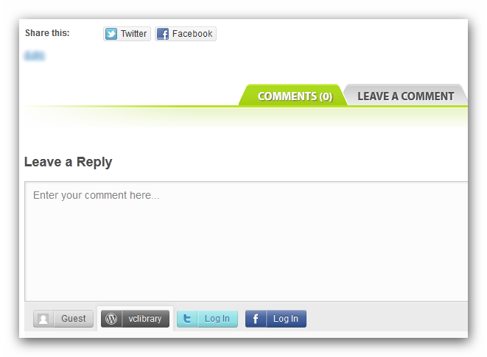
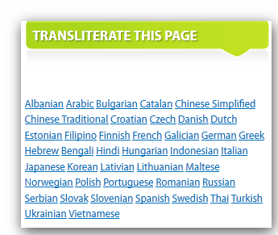
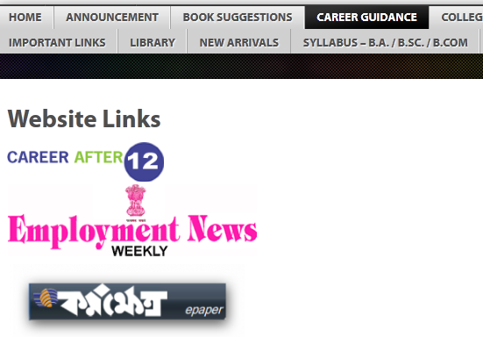
Our Blog: Some features- 2

Slide 24
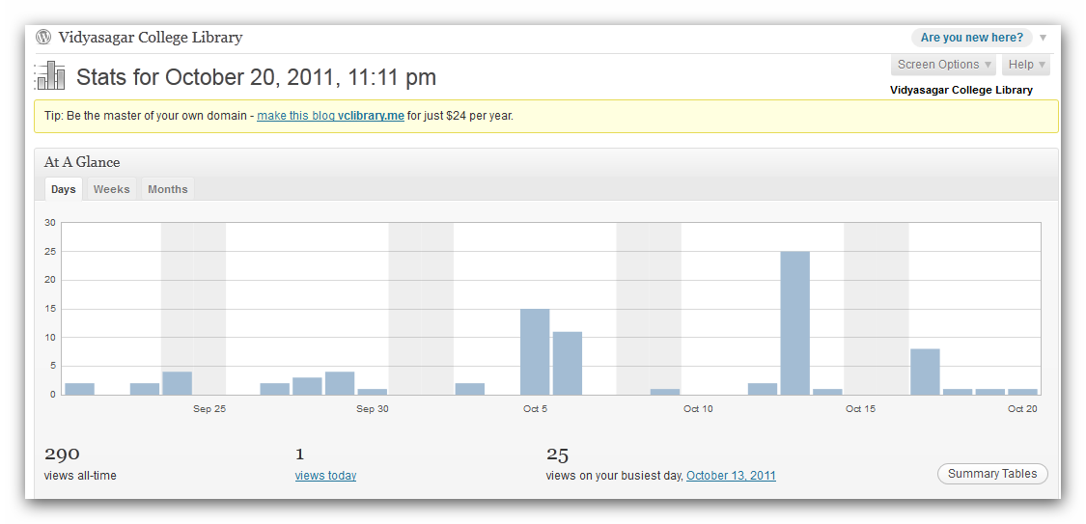
Usage Statistics

Slide 25
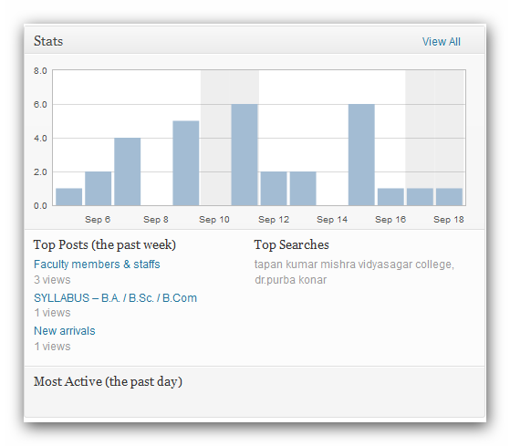
Top searches
According to our statistics, most frequent visitor is Dr. Tapan Kumar Mishra, Principal, Vidyasagar College.
So, attracting people are not a very difficult job but more difficult thing is to retain all users for a long time.

Slide 26

Now it's your turn and be an administrator of your library blog… just begin with an internet connection & PC…. Good luck.

